Slide 1
Pre Check List
OTP Register map check.
AHB register map check
Rely on otp register map to check NumOfBits is correct or not.
All the register in VBT Gen test plan is in the ahb_register_map or not => need to check all test flow sheet and test
parameter sheet.
Check the input value also:
W/O field 1Byte : 0~255
&H0~&HFF
W field : according to field width in AHB register map to have a boundary check
5. All the pin in VBT Gen test plan is in the pin_map or not => need to check all test plan flow and test parameter sheet.

Slide 2
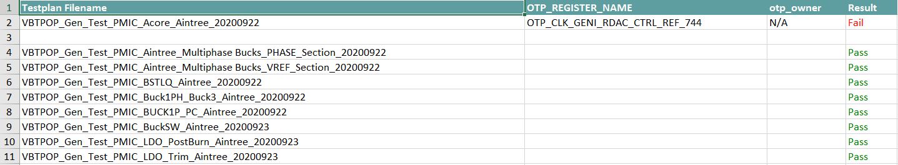
OTP_register_map => item 1
OTP Register owner check.

Slide 3
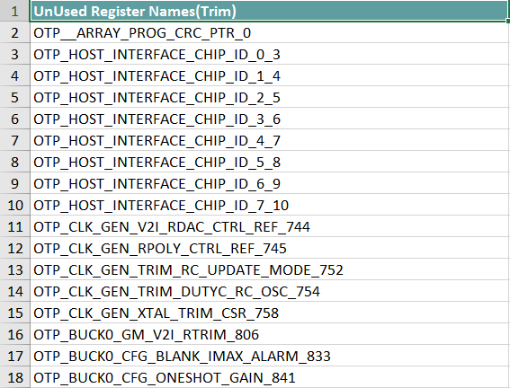
OTP_register_map => item 1
Check unused OTP Register names

Slide 4
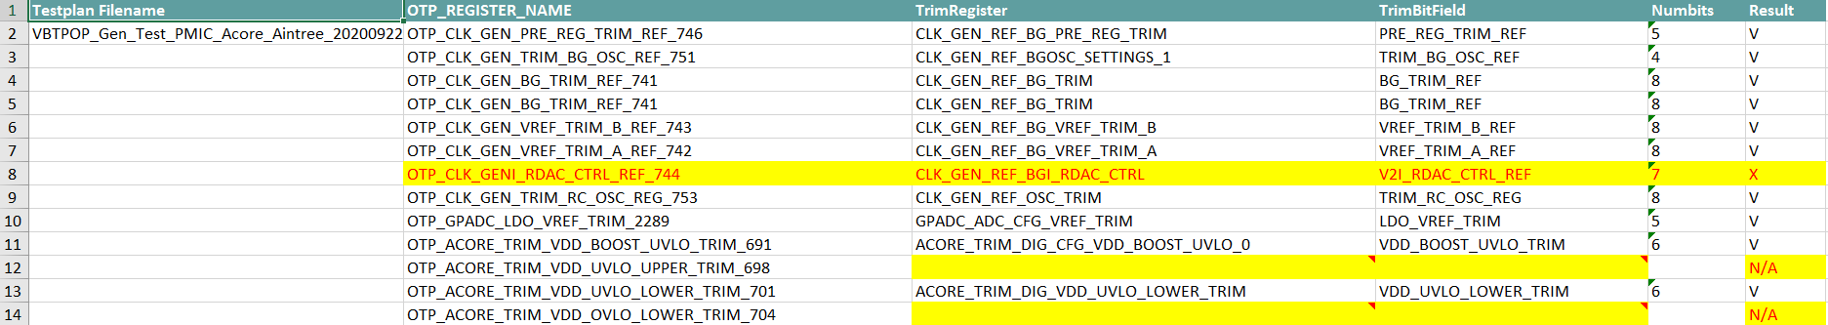
OTP_register_map => item 1
Check trim register

Slide 5
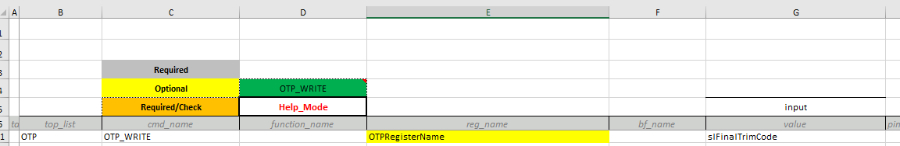
Command need to be checked in test flow sheet
The column otp register name should exist in the OTP register

Slide 6
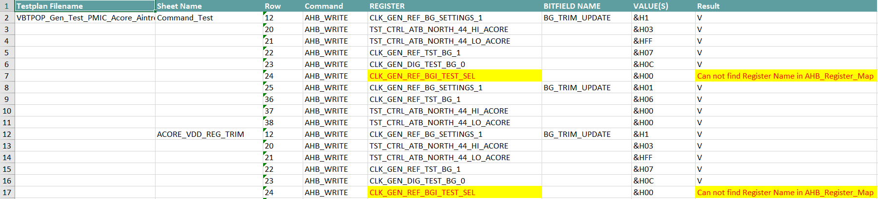
AHB_register_map.txt => item 2/3/4
Check Test flow register

Slide 7
AHB_register_map.txt => item 2/3/4
All the register in VBT Gen test plan is in the ahb_register_map or not => need to check all test flow sheet and test
parameter sheet.
Check the input value also:
W/O field 1Byte : 0~255
&H0~&HFF
W field : according to field width in AHB register map to have a boundary check

Slide 8
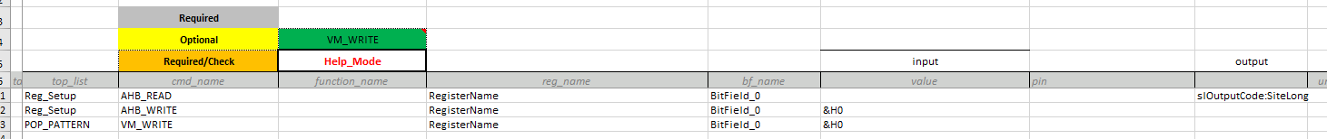
Command need to be checked
Note: Bit Field is optional
W/O field 1Byte : 0~255
&H0~&HFF
W field : according to field width in AHB register map to have a boundary check

Slide 9
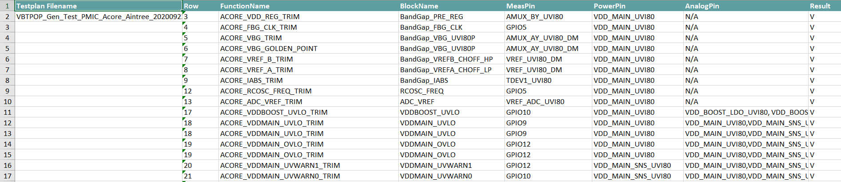
PinMap.txt => item 5
All the pin in VBT Gen test plan is in the pin_map or not => need to check all test plan flow and test parameter sheet.

Slide 10
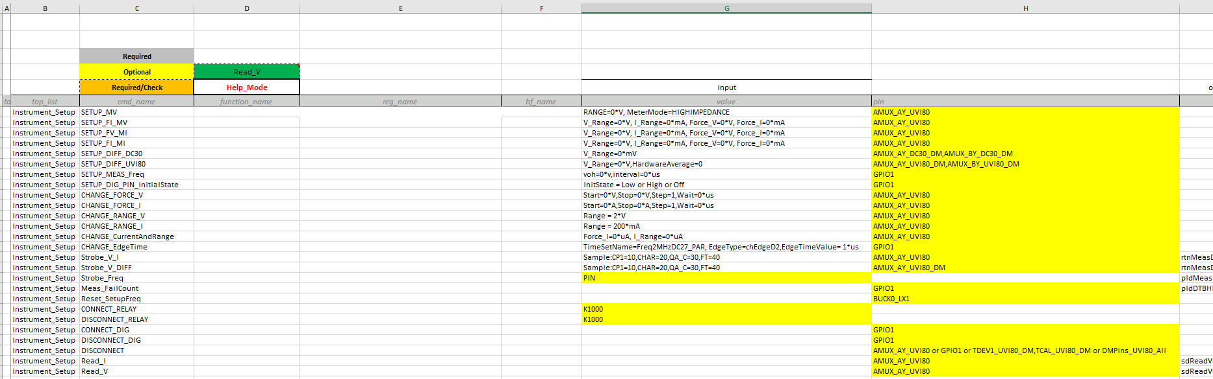
Command need to be checked - 1
Note: consider the multiple pins
Ex:

Slide 11
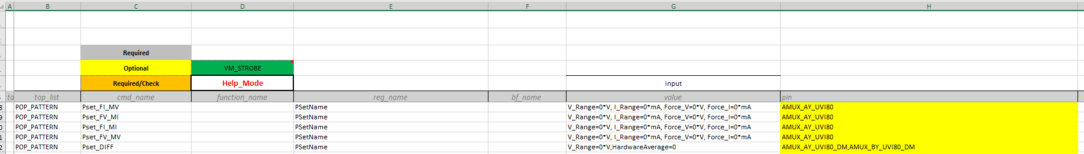
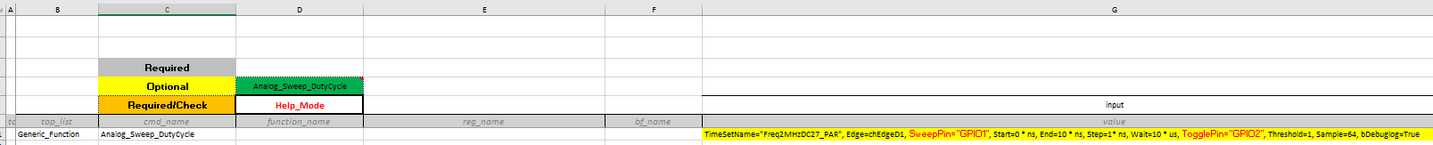
Command need to be checked - 2
Consider the multiple pins for the PSet command

